Slide 1
Arduino Workshop #1
These workshops are based on the book Exploring Arduino by Jeremey Blum. $37.44 on Amazon.
Notes:
12 Arduino Uno
12 USB cables

Slide 2
PowerPoint and Code
Github.com/EELabMan
Go To Repositories and find Arduino 1 Digital Pulse Modulation

Slide 3
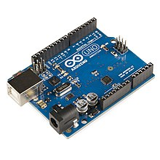
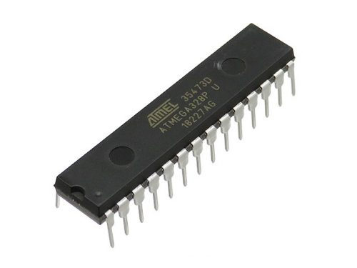
What is an Arduino?
The Arduino is an entry level Micro-controller
The IC (Integrated Circuit) chip is the microcontroller.
It plugs into a development board so you can easily attach sensors and other devices to it.
Chips come in different packages.
We will use the Arduino Uno R3 with the 28 pin DIP (Dual Inline Package) package.
The chip is actually called the Atmel ATMEGA 328P-PU. Data Sheet Here.

Slide 4
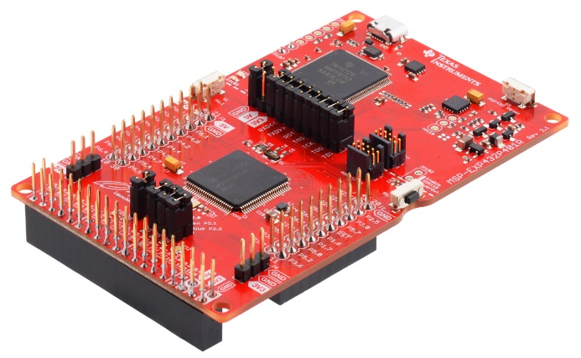
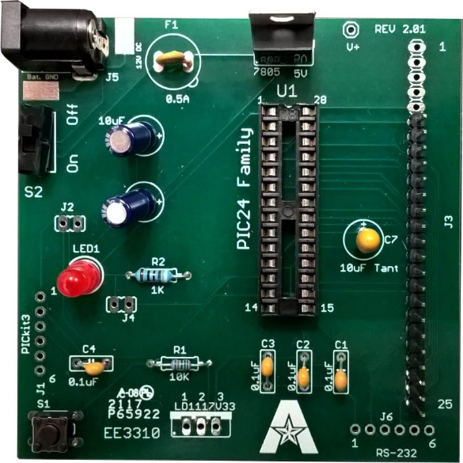
Other Micro Controllers
Other microcontrollers you will see during your EE education are
Texas instruments MSP-430/432.
MicroChip PIC16
All chips have different models to accommodate what your design needs are.
Number of input/output pins, package ( Size ), processor speed?
Built in Wifi or Bluetooth needed?

Slide 5

Let’s get started already
You will need the Arduino Uno R3 microcontroller and a USB cable for this first workshop.
You will need to download the Arduino programming software also.
Go to https://www.arduino.cc/en/software and download the Win7 or newer version and install it.
If you have a Mac or Linux please download your correct version.
The Software is called the Arduino IDE (Integrated Development Environment)
Open the Arduino Program.

Slide 6
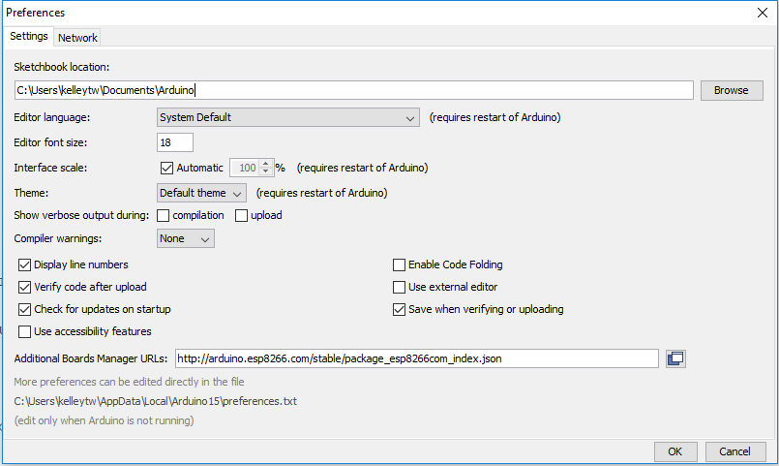
Let’s get organized
Go to file -> preferences
Here you can change the text size
Ensure Display line numbers is selected also.

Slide 7
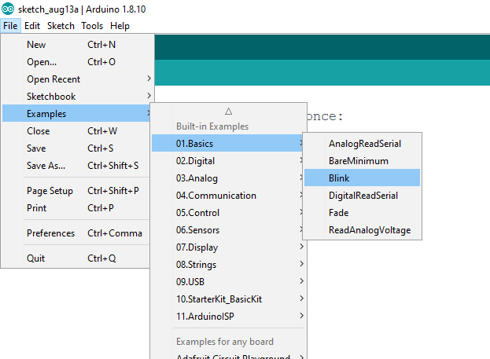
Examples
Let’s load a program to blink the on-board LED.
File-> Examples -> 01.Basics -> Blink

Slide 8
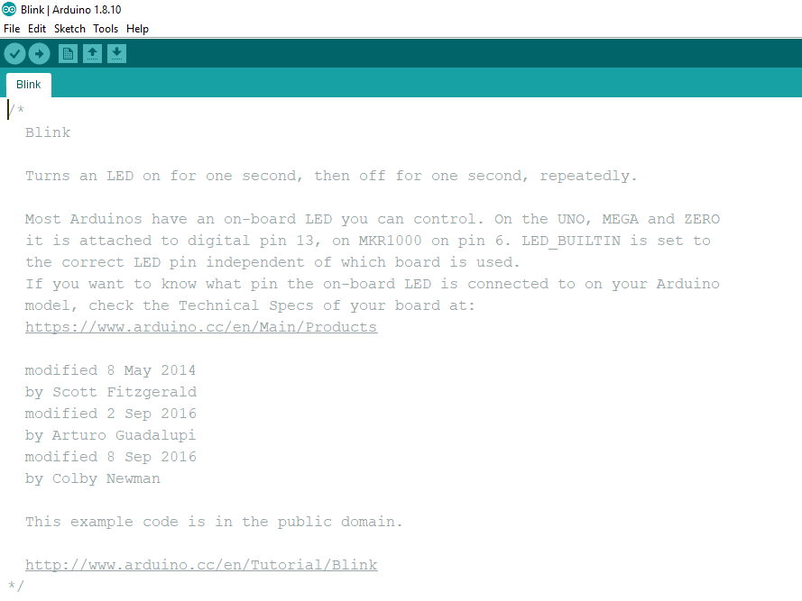
Header
The header “ Comments” at the top of the program explains that pin 13 of the ATMEGA328 has a LED attached to it on the development board (The Uno).
Notice the text is in between /* and */. This lets you use comments just like in the C programming language. Always write comments so you can remember what does what. It can get very complicated!

Slide 9
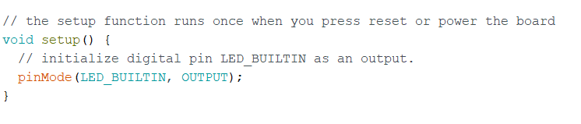
Set up
The setup function always goes first.
The void before the setup just means this function does not return any values
The keyword pinMode lets you set the pin to an output or and input.
LED_BUILTIN is defined already as pin 13 for the UNO. You could also just write 13 here.
Notes:
The void in front of set up means we don’t have to give the function any data to make it work. Functions are defined by the ()

Slide 10
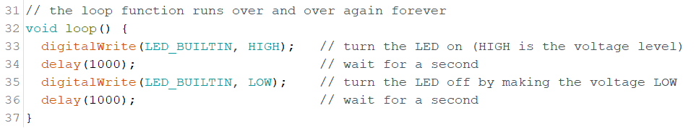
Loop
The loop function must be present.
It loops.
Enter this into your program.
Delay(1000) will delay the program 1000ms or 1 second. This blinks the LED off and on every second.

Slide 11
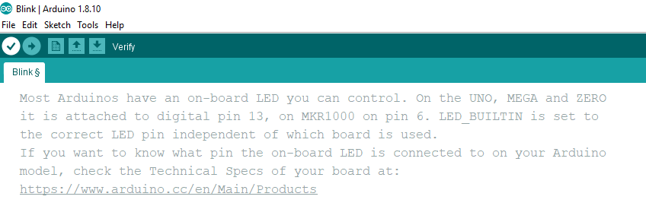
Error checking your code
Click the check to verify your code is correct.

Slide 12
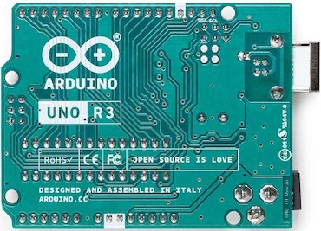
WARNING – BEFORE YOU PLUG IN THE USB/POWER CABLE
The bottom of the development board has exposed solder joints. ANY contact with metal can fry the UNO.
Always place the Uno on a NON-CONDUCTIVE table.
Keep jumper wire away from the Arduino Uno.
ALWAYS power off the Arduino when adding / removing wires or components.

Slide 13
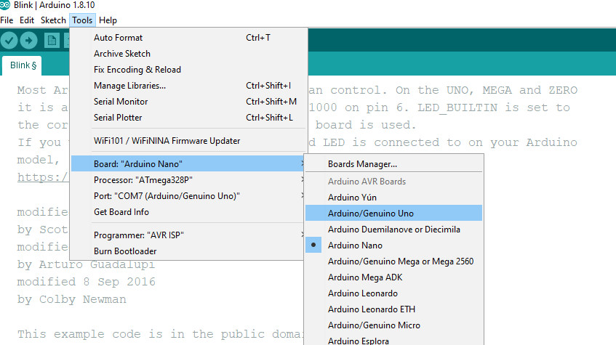
Connect
Plug in your Arduino with the USB cable. This supplies power and communications to the Arduino IDE
Select Tools -> Board:”Current board” -> Arduino/Genuino Uno

Slide 14
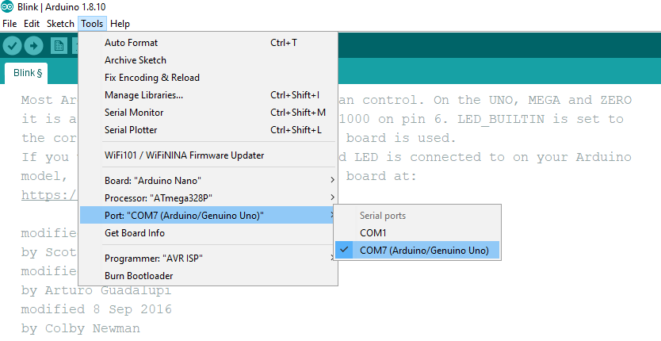
Com Port
Select – Tools -> Port:”Current port” -> Com port your Arduino was assigned by the computer.
When you connect a USB device to the computer it shows up in the Device Manager for windows computers.
Let me know if you can’t connect.

Slide 15
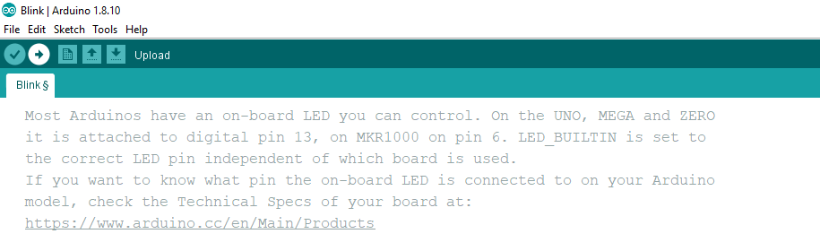
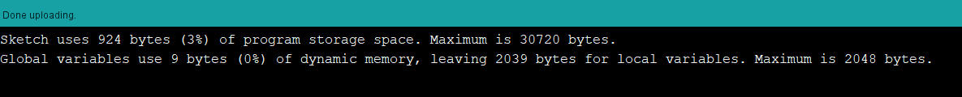
Final step to Blink the LED
Click the “Upload” Right arrow to send your code into the ATMEGA328.
The terminal window should show done uploading.
Change the delay time and upload again.
How fast can you blink the LED until it looks like it’s always on.
Some experts will tell you that the human eye can see between 30 and 60 frames per second. Some maintain that it's not really possible for the human eye to perceive more than 60 frames per second.

Slide 16
Digital Outputs

Slide 17
Working with breadboards
Now we are going to learn how to make and use external circuits
To do this we will use a breadboard to prototype circuits

Slide 18
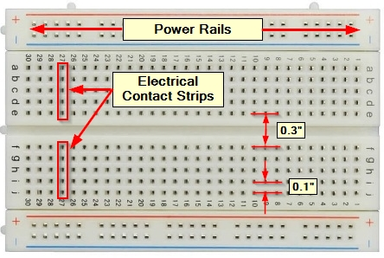
What is a breadboard?
Pros:
Inexpensive and easy to get up and running
Circuits can be constructed easily and quickly
Wires can also be used to connect that circuit to a microcontroller
No soldering is required.
Changes to the circuit can be made easily
Can be easily removed and reused in a new circuit in the future.

Slide 19
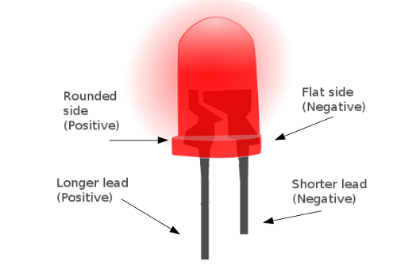
Wiring LED’s
LEDs (light emitting diodes) will be heavily used
LED’s are
Polarized
Direction of connection matters
The flat side or shorter lead is the cathode (negative lead)
The positive lead is the anode
Need a resistor in series (on either the positive or negative side)
Too much current can damage the Arduino
We will use 220 Ω resistors

Slide 20
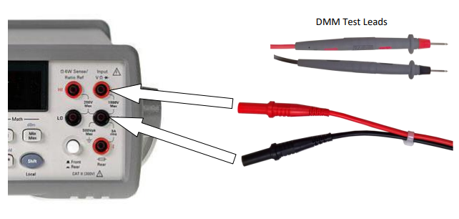
Testing LED’s
LEDs (light emitting diodes) are diodes
The 34401A Digital MultiMeter on the lab bench has a Diode Checker. Shift -> CONT
Grab a set of DMM Probes and test the LED.
It’s OK to touch the leads.

Slide 21
Ohm's Law / Current Limiting Resistor
Voltage (V) represents electrical potential
Current (I) flows from high potential to low potential
Resistance (R) is the opposition to the flow of electrons
Ohms law states:
V = I R
All voltage is “used” in a circuit
LED’s have a predefined voltage drop across them ( See the Diode Datasheet ) ~2V
Need a particular current
Typical of 30 mA Max 90mA
Diode
Thus we see
2 volts/(30 mA) = 66 Ω
As resistance increases -- current lowers
We use 220 Ω to insure the max amperage is not exceeded (safety factor)

Slide 22
Power Equation / Choosing the Resistor value
We also know the power equation
P = I V
Power is the current times the voltage
Standard Resistor’s have a power rating of
1/4 W (250 mW)
We know the LED will drop 2V, so the resistor will drop 3V if we use 5V to power the system.
P = 3 V *0.03 A = 90 mW
Which is less than 250 mW
Resistor gets to keep “The Magic Smoke!”

Slide 23
Pulse Width Modulation with AnalogWrite()

Slide 24
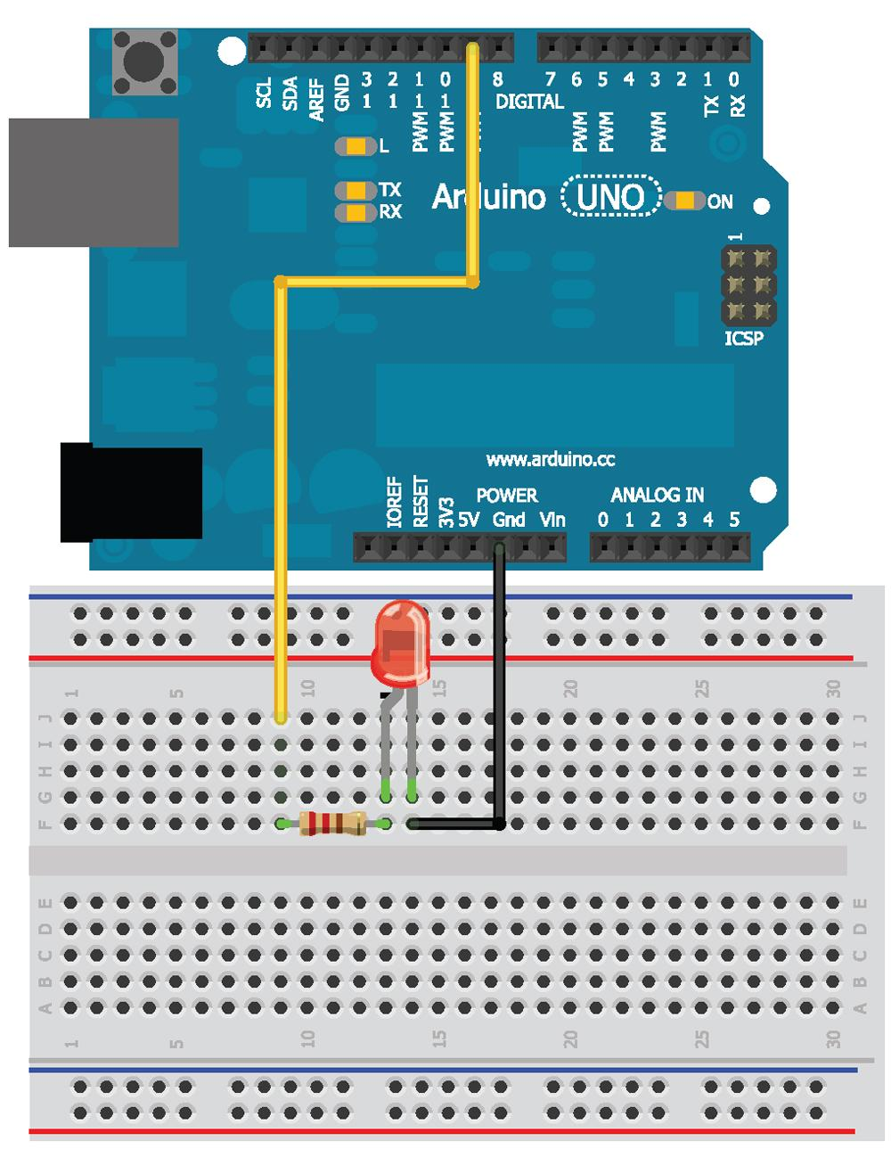
Let's wire up the Circuit

Slide 25
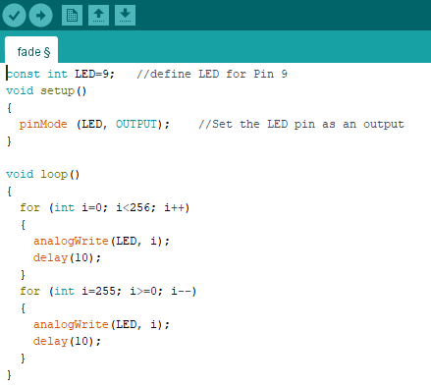
Pulse Width Modification (PWM)
We can’t get analog outputs
But we can get close with pulse-Width modification (PWM) and the analogWrite() comand
Download or copy the fade.ino file from the GitHub page

Slide 26
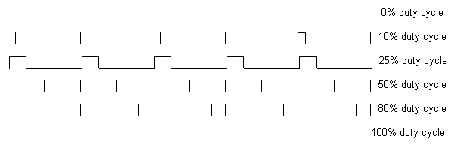
PWM - what's actually happening?
PWM works by modulating the “duty cycle” (the percentage of time the voltage is high vs. low)
The analogWrite() command sets the duty cycle depending on the value you pass it
0 -- always off
225 -- always on
127 -- 50% cycle
YOU NEVER CHANGE THE VOLTAGE

Slide 27
Stay tuned
Arduino 2 will cover Digital and Analog inputs
We’ll use a button, a potentiometer, a RGB LED, a temperature sensor and a photo diode!

